Slide 1
Don't Just Sit There! Start Logging

Slide 2

About Me
Business Applications MVP
Maker of D365 Developer Tools
Blog: https://jlattimer.blogspot.com
GitHub: https://github.com/jlattimer
Twitter: @JLattimer
Jason Lattimer
Development Manager PowerObjects

Slide 3
Why Do We Log?
To see what’s going on of course
Bugs
Metrics
Feature use
Lack of faith

Slide 4
Bugs
Things missed in testing
Exception details
Exception type / stack trace
Source method
Accompanying info
Data in process
Date & time
User / location
I.E. – things to identify future test cases

Slide 5
Metrics
Performance
Page load
Job duration
Web service response
Query time
Proactive
Track over time
Prioritize optimization
Identify patterns

Slide 6
Feature Use
Drive decisions
A/B testing
What to keep
What not to keep

Slide 7
Lack of Faith
In the…
Users
Data
Network
Security

Slide 8
D365 Logging Today
Plug-in trace log
Organization Insights
No direct create – needs intermediary process
Can’t trigger workflow / alerts
Poor search
Custom Entity
Extra overhead

Slide 9
Microsoft Application Insights
Centralized repository
Simple logging via HTTP Request
Use from anywhere!
Dashboard & analytics
Power BI & Visual Studio integration
Export & import
Alerts

Slide 10
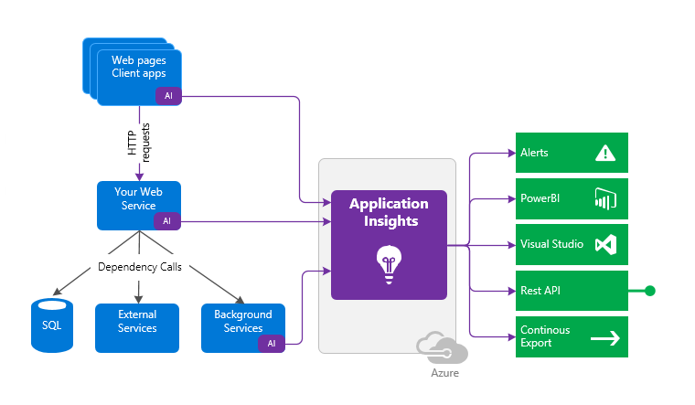

Slide 11
Application Insights in D365
General fear of Azure
D365 already there &
soon it will all be Azure
Costs money
5GB / month free then $2.30 USD (€2,522) per GB
Sample client-side example integration isn’t useful
Misconception that merging assemblies is required
Custom implementation using HTTP requests

Slide 12
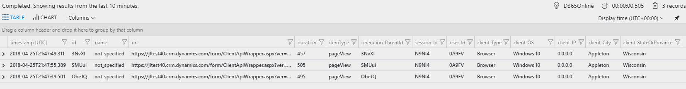
OOB - Pageview

Slide 13
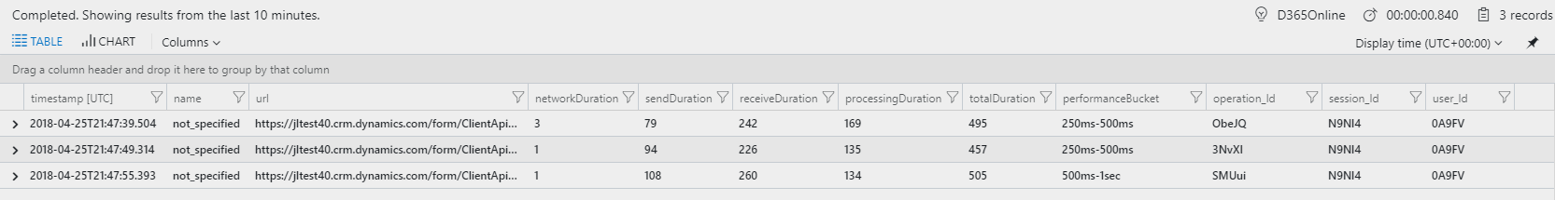
OOB – Browser Timings

Slide 14
Data Model – Telemetry Types
Dependency
Outbound to web services, SQL, etc.
Request
Inbound to application
Exception
Errors
Metric
Single or aggregate measurements
Trace
Informational messages
Event
Application interactions

Slide 15
Data Model – Custom
Custom dimensions
<string, string>
Custom measurements
<string, double>
Uses
Org. name / version
Execution context values
Current user / record

Slide 16
Client Side Logging D36AppInsightsJS
Custom implementations
Page view & duration
Trace
Dependency / duration
Exception
Metric
Event
Method time

Slide 17
Client Side Logging D36AppInsightsJS
Custom dimensions
Current user id
Entity id / name
Form name
Org. name / version
Source (JavaScript)

Slide 18
Server Side Logging D365AppInsights
Custom implementations
Trace
Dependency / duration
Exception
Metric
Event

Slide 19
Server Side Logging D365AppInsights
Custom dimensions
Execution context
User id & impersonating user id
Entity id / name
Org. name / version
Source (Plug-in / Workflow)
Mode, depth, message, correlation id
Stage (Plug-in)
Category (Workflow)
Input & output parameters

Slide 20
Application Insights Tour (abbreviated version)

Slide 21

Demo & Code

Slide 22
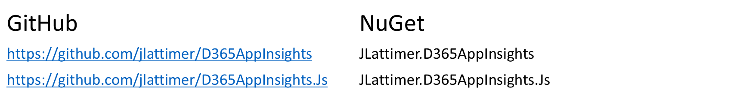
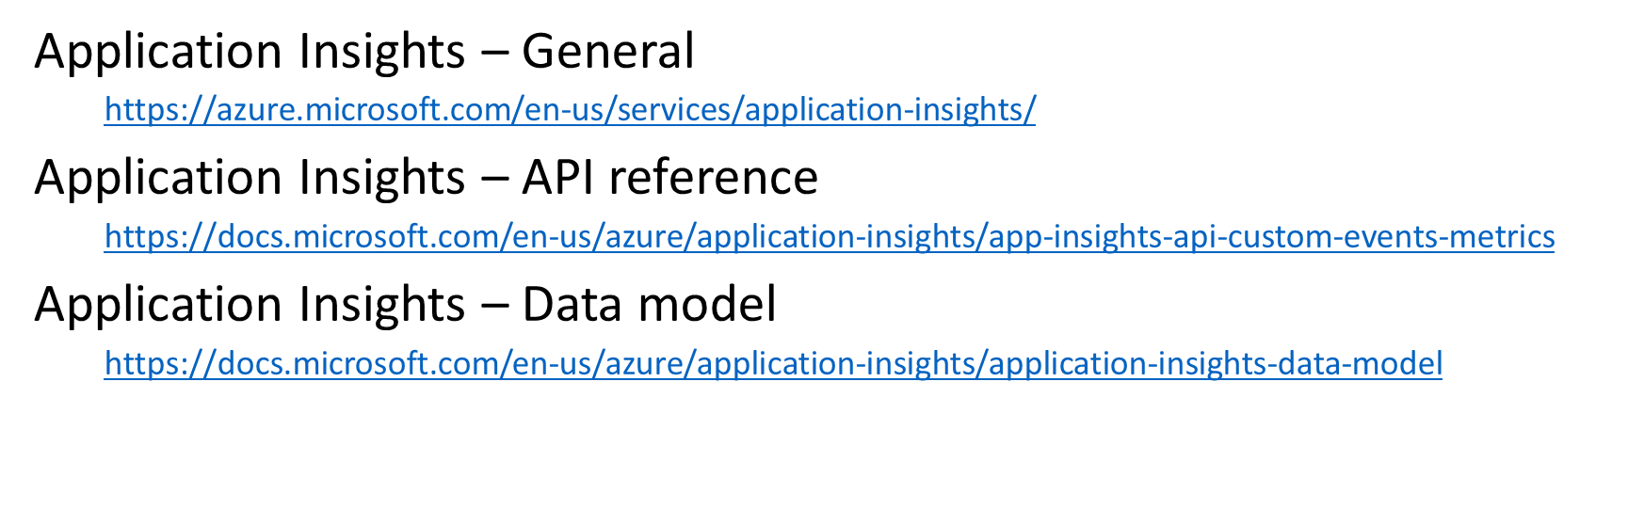
Resources

